Slide 1
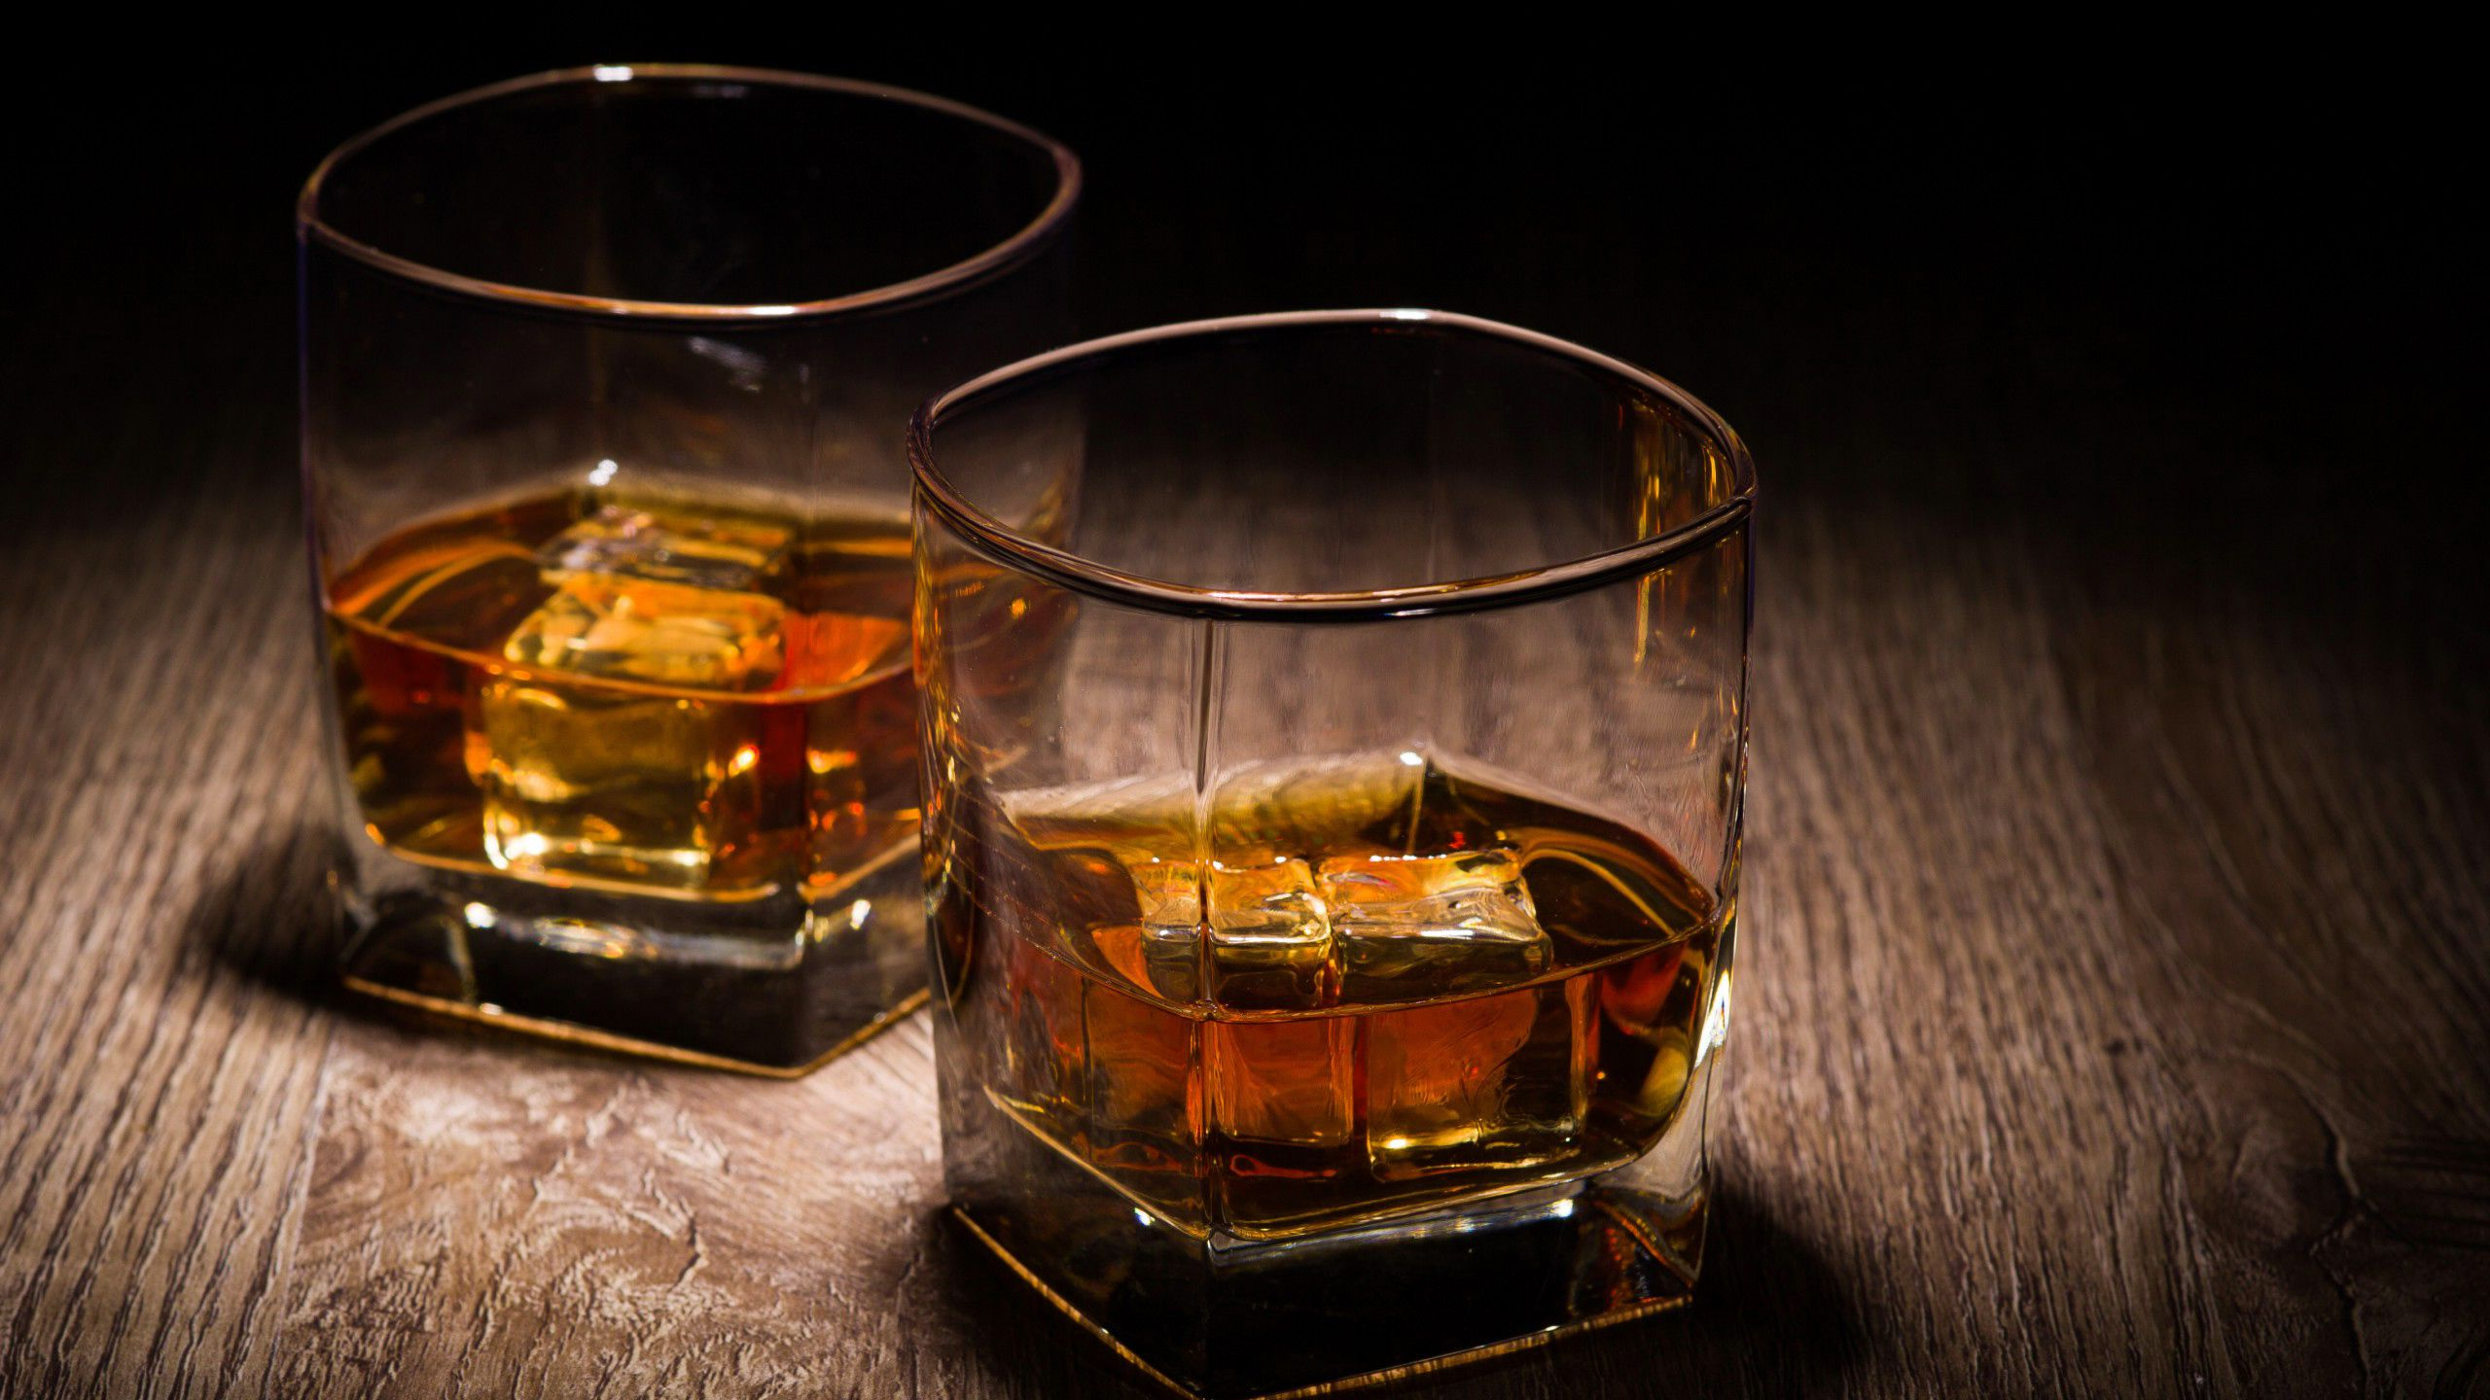
Which Whisky Wins?
Identifying value for money in the world of whisky
Gareth Harper | Feb 2022 | GA London DSI21

Slide 2
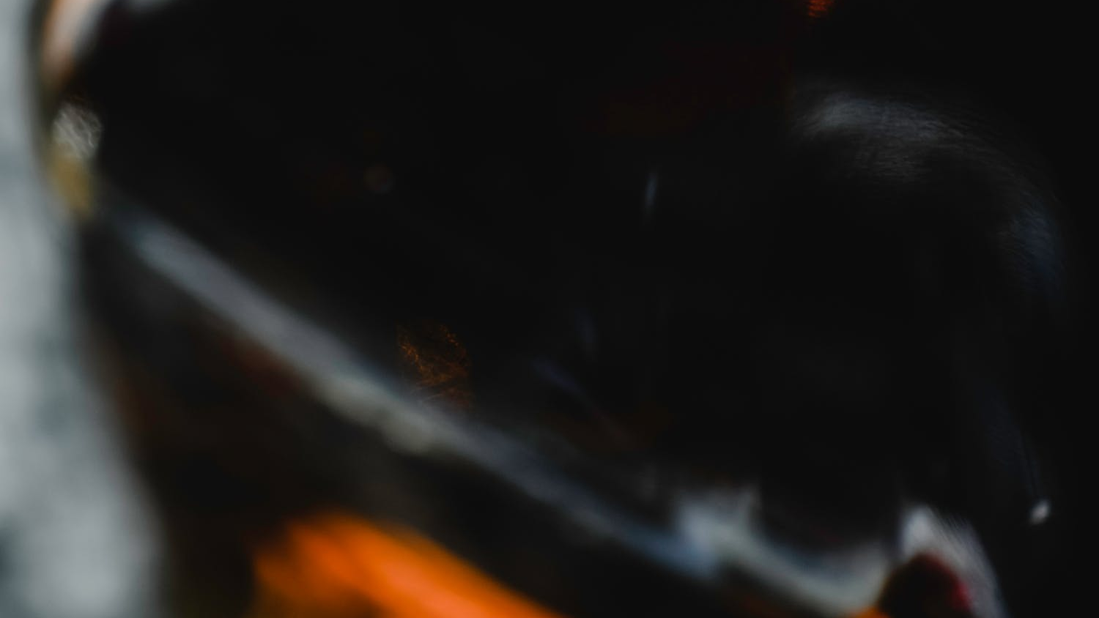
Some interesting trivia to whet your appetite:
Spelled whiskey in Ireland and USA, and whisky in Scotland and Canada
World Whisky Day is held on the 3rd Saturday of May every year
Whisky in Gaelic reads “uisge beathe”, which means “water of life”
Taylor Swift has 21 songs with alcohol references, 4 of which specifically mention whisky
Approximately 2% of whisky gradually evaporates through the barrels each year. This is famously known as the angel's share
There are more casks of aging whisky than there are people in Scotland
As of 2015, Scotland exports whisky at a rate of just under 2500 bottles per minute, generating £135 of revenue every second

Slide 3
Some interesting trivia to whet your appetite:
Spelled whiskey in Ireland and USA, and whisky in Scotland and Canada
World Whisky Day is held on the 3rd Saturday of May every year
Whisky in Gaelic reads “uisge beathe”, which means “water of life”
Taylor Swift has 21 songs with alcohol references, 4 of which specifically mention whisky
Approximately 2% of whisky gradually evaporates through the barrels each year. This is famously known as the angel's share
There are more casks of aging whisky than there are people in Scotland
As of 2015, Scotland exports whisky at a rate of just under 2500 bottles per minute, generating £135 of revenue every second
So how do you capitalize on this?
If you were a large-scale retailer, you would want to:
Buy your product at the lowest possible price, and
Sell it at the highest possible price,
Thereby maximizing profit!

Slide 4


My Hypothesis: Can I identify whiskies that provide the best value for money?
To do this I investigated the factors affecting whisky prices, made price predictions based on the data, all to allow whisky buyers to make better informed decisions when purchasing whisky.
Consider the following simple formula:
Value = $\frac{Predicted Price}{Actual Price}$

Slide 5
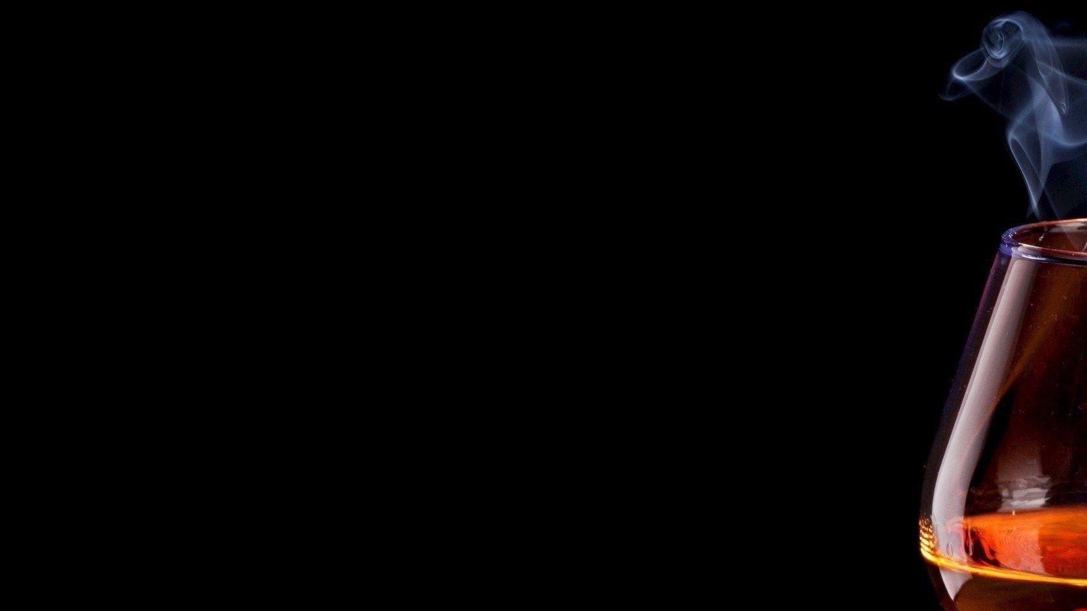

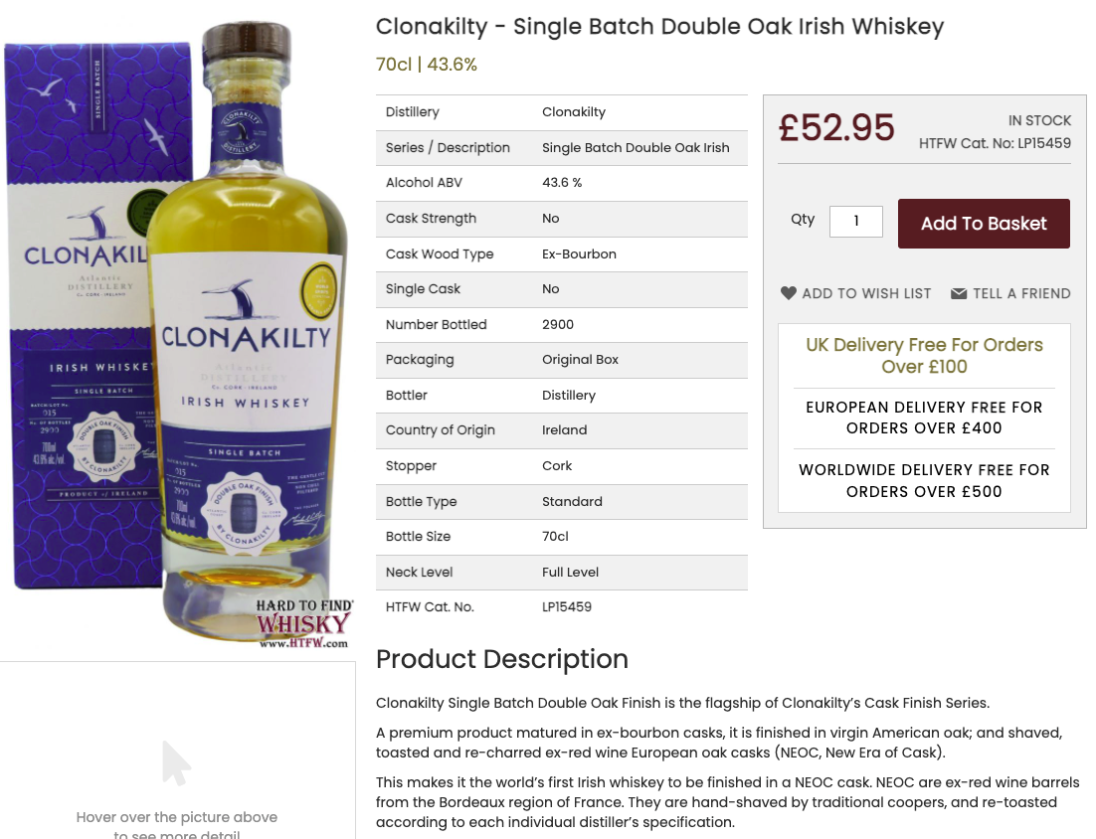
The Data Obtained from htfw.com (Hard To Find Whisky)
A retail website selling over 6,600 different whiskies. I performed a web scrape to get the data.
Distillery refers to the “company” making the whisky. Some familiar names include Macallan, Johnnie Walker, Jameson etc.
Series refers to the “edition” of the whisky. Typically a single distillery will produce numerous whiskies
Cask strength is a term used in the industry to describe a whisky that has not been substantially diluted (usually with water) after its storage in a cask
Cask wood not only refers to the wood used for the cask, but whether the cask is new or previously used
Single cask refers to whisky drawn from one individual cask. This is not to be confused with single malt vs blend
Bottler here refers to whether the whisky is bottled at the distillery it is made, or at a bottler independent of the distilling process

Slide 6
Cleaning
Some notable cleaning operations include:
Series and Description variables were subset for NLP
I filtered out spirits that were scraped that were not whisky e.g. gin, rum, vodka etc.
Cask Wood Type was grouped into 8 broad categories (down from 146 unique cask types)
Single Cask, Bottler and Cask Strength variables were binarized
Price was initially based on the bottle size that I standardized to be Price/unit volume
Price was transformed to lognormal to get a normal distribution for my target variable
Using the relationship Year Bottled = Vintage + Age I was able to impute missing values
IterativeImputer was used for remaining missing values for these 3 columns
Outliers were removed using percentiles (values <1% and >99% were removed)
The final dataset comprised 16 features and 5,660 whiskies

Slide 7
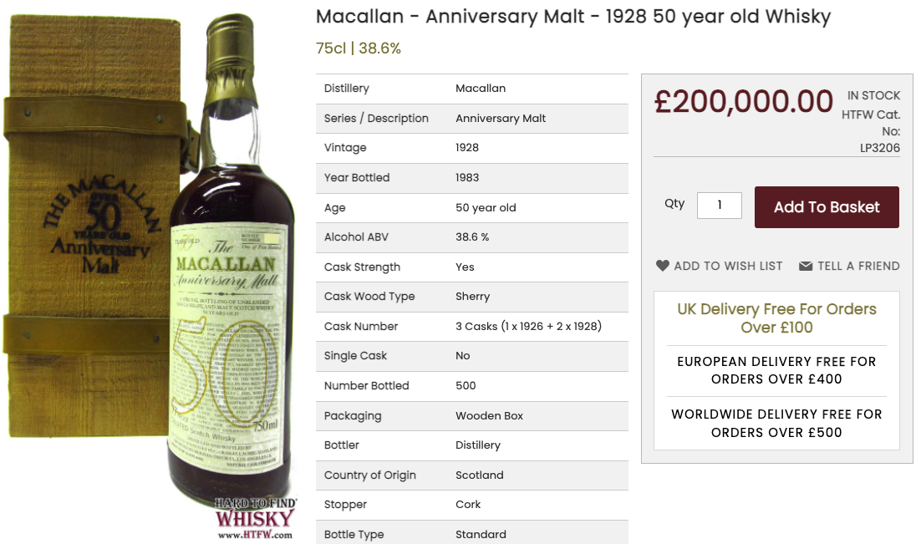
Target Variable = Price:
X
£267,000 / litre

Slide 8
Target Variable = Price:

Slide 9
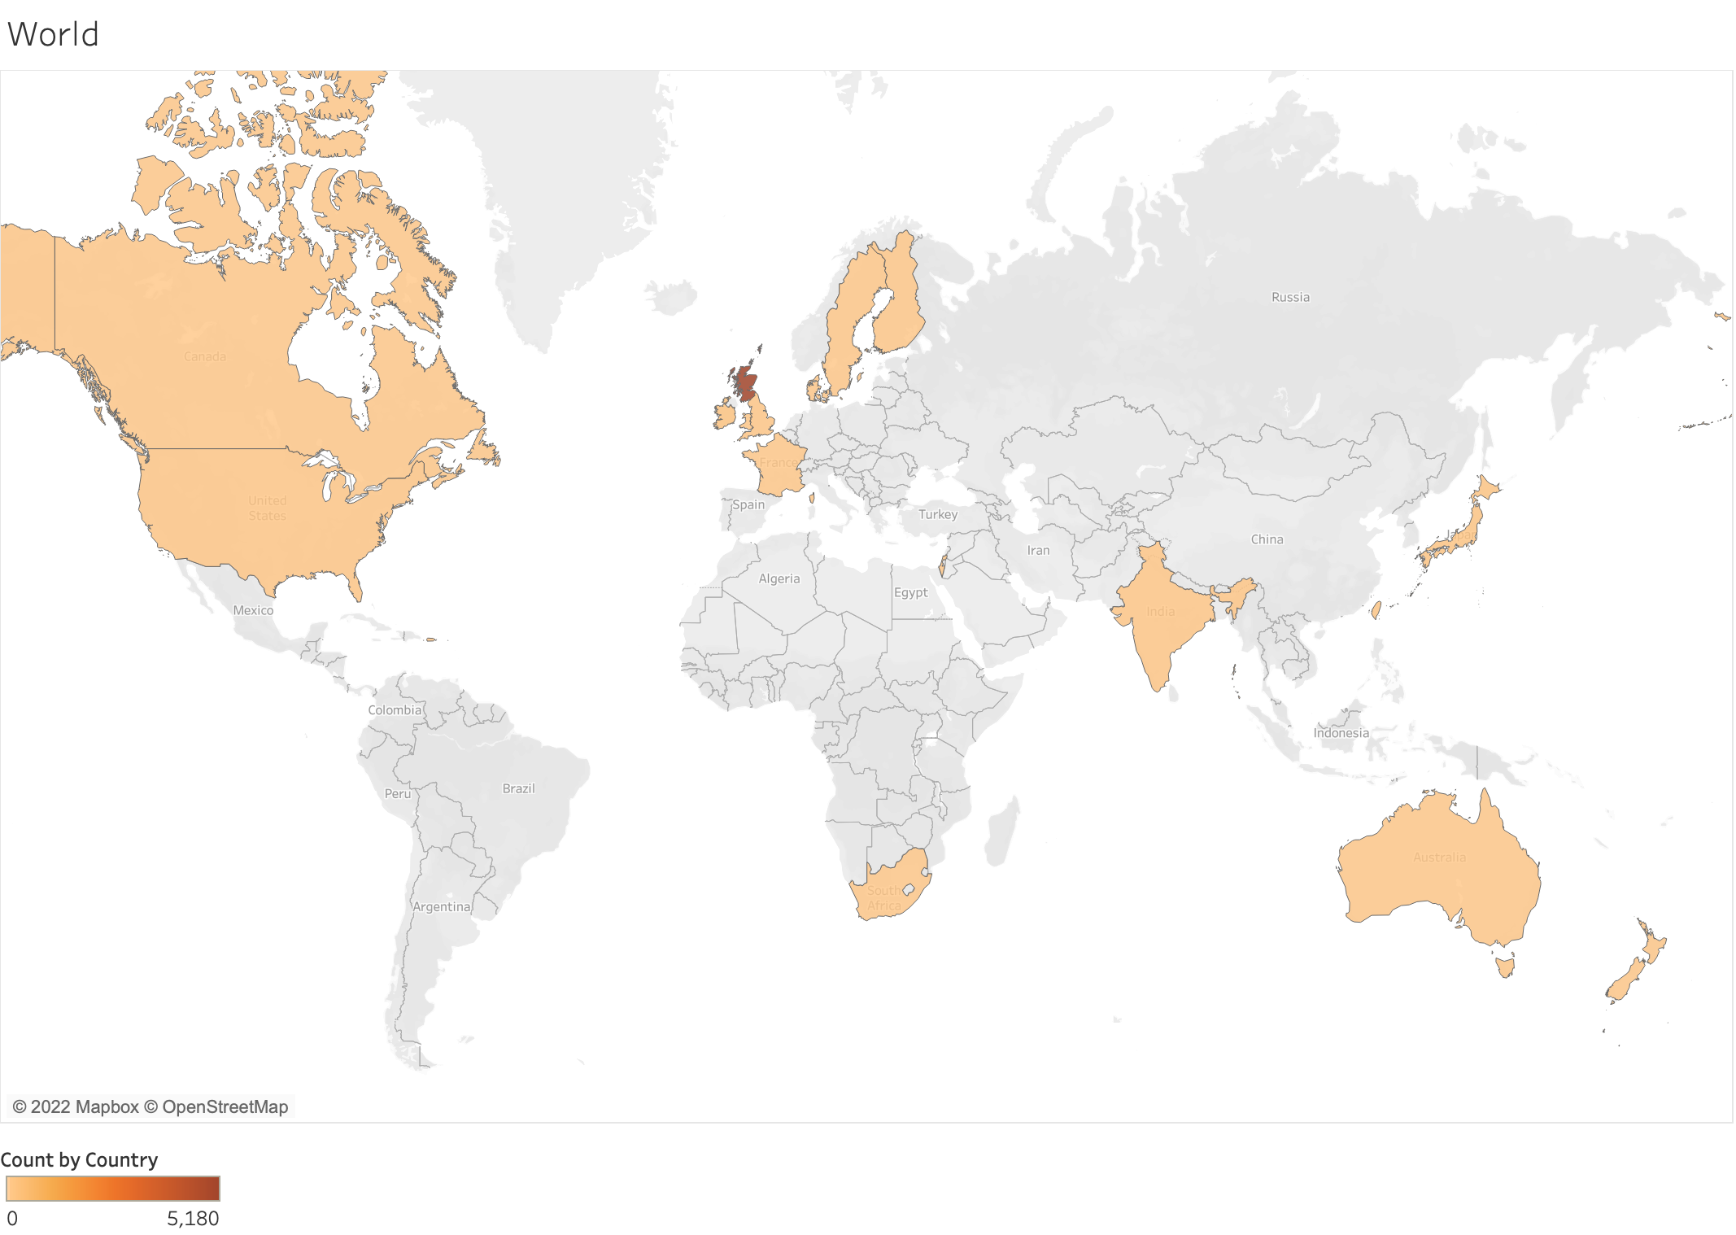
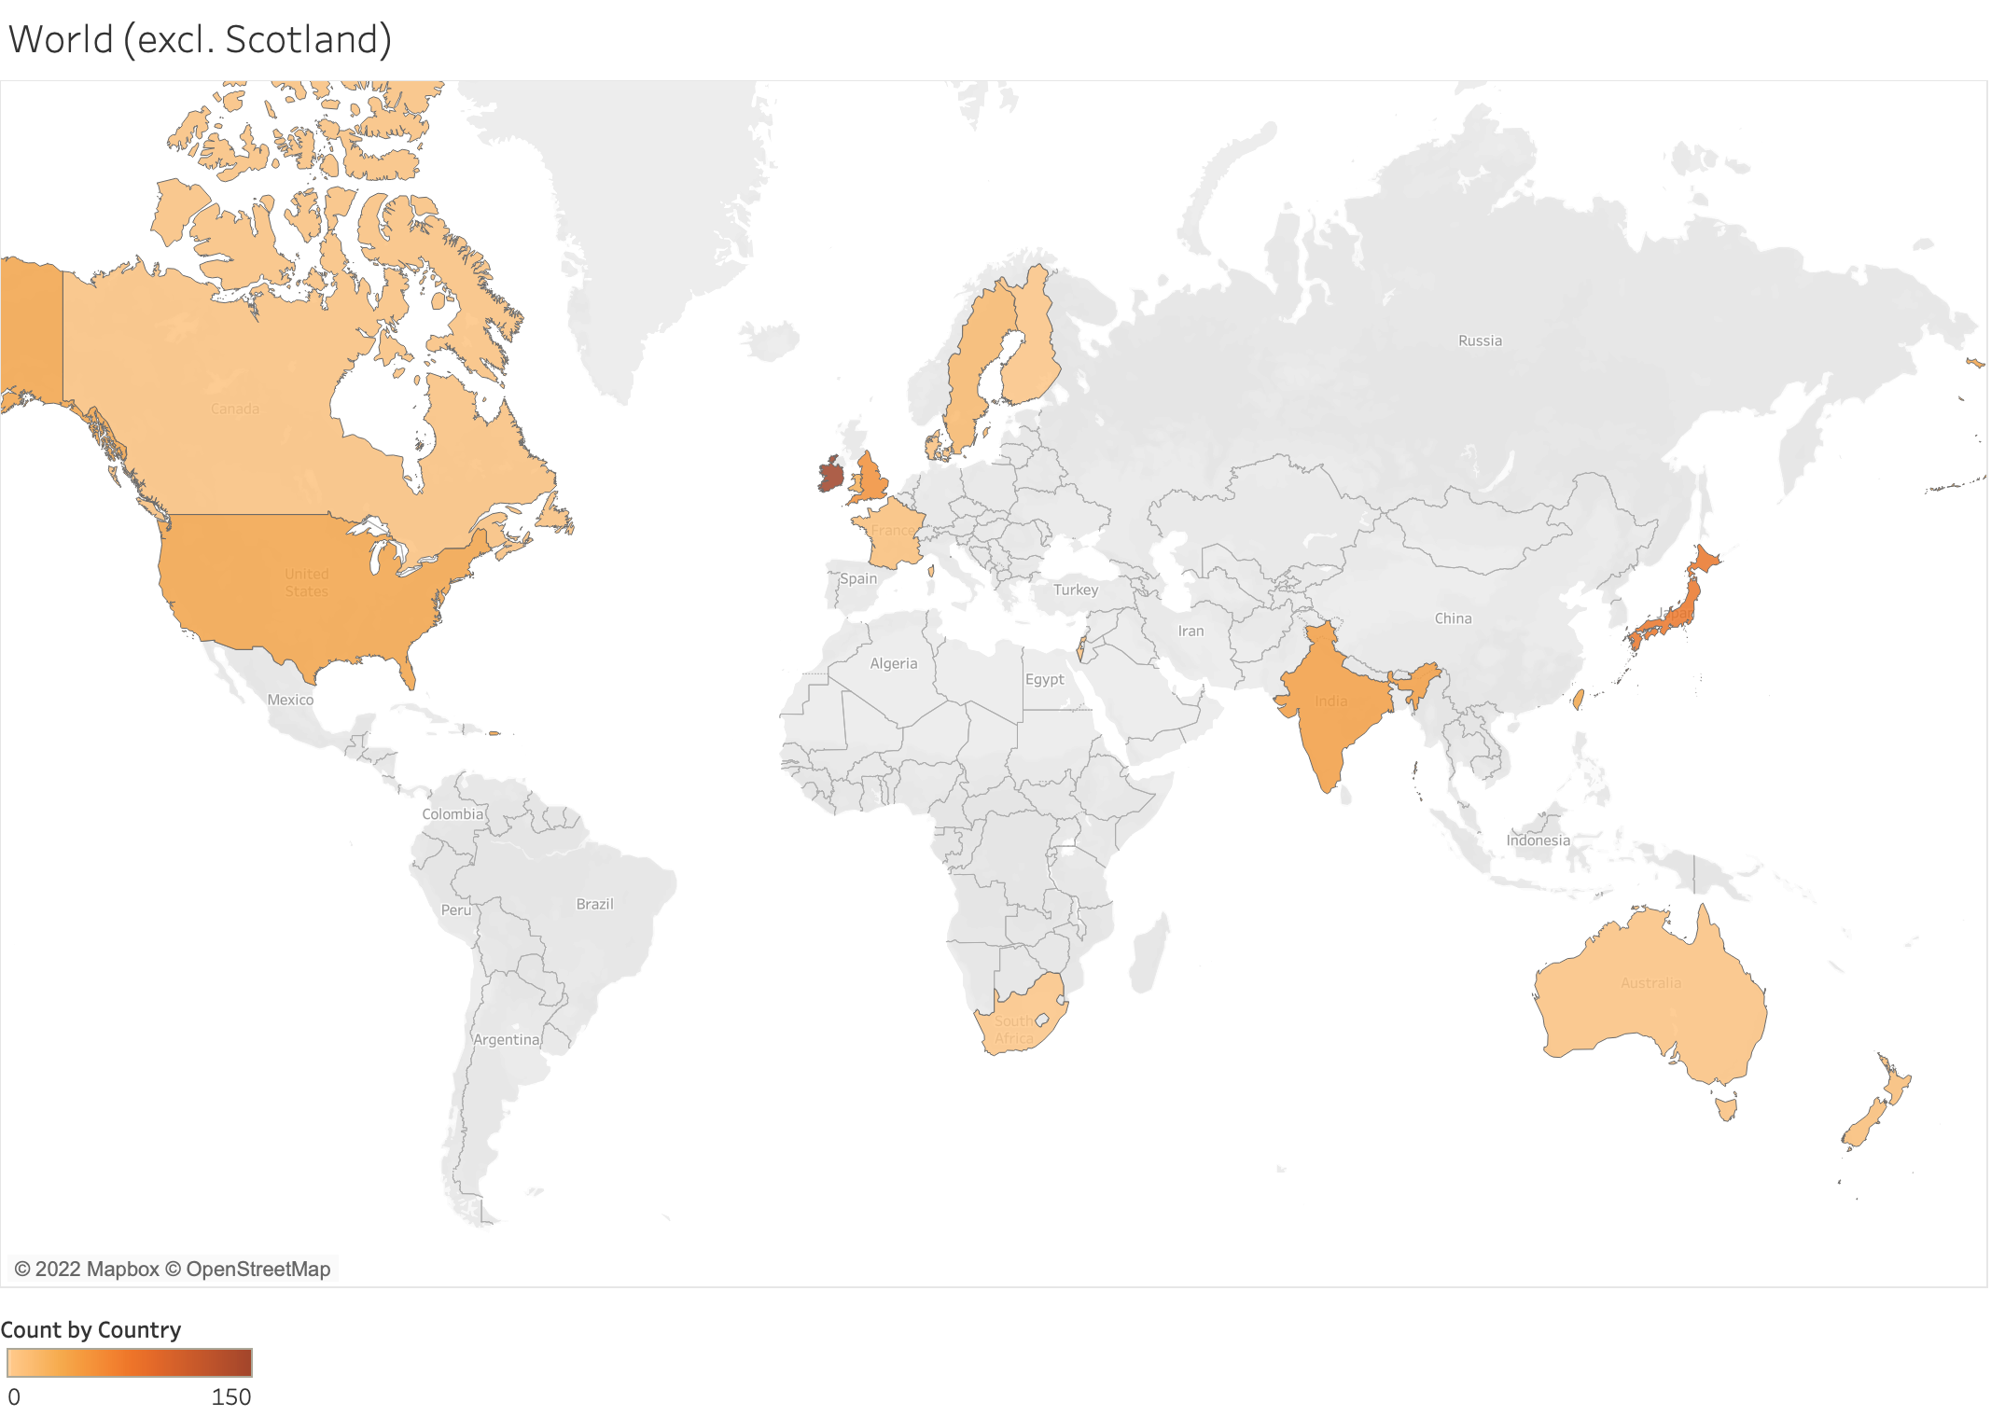
EDA:
1. Scotland = 5,187
4. England= 52
2. Ireland = 152
5. USA = 37
3. Japan = 78
5. India = 37
Obtained whiskies from 17 different countries, more than 90% from Scotland

Slide 10
EDA:

Slide 11
EDA:

Slide 12
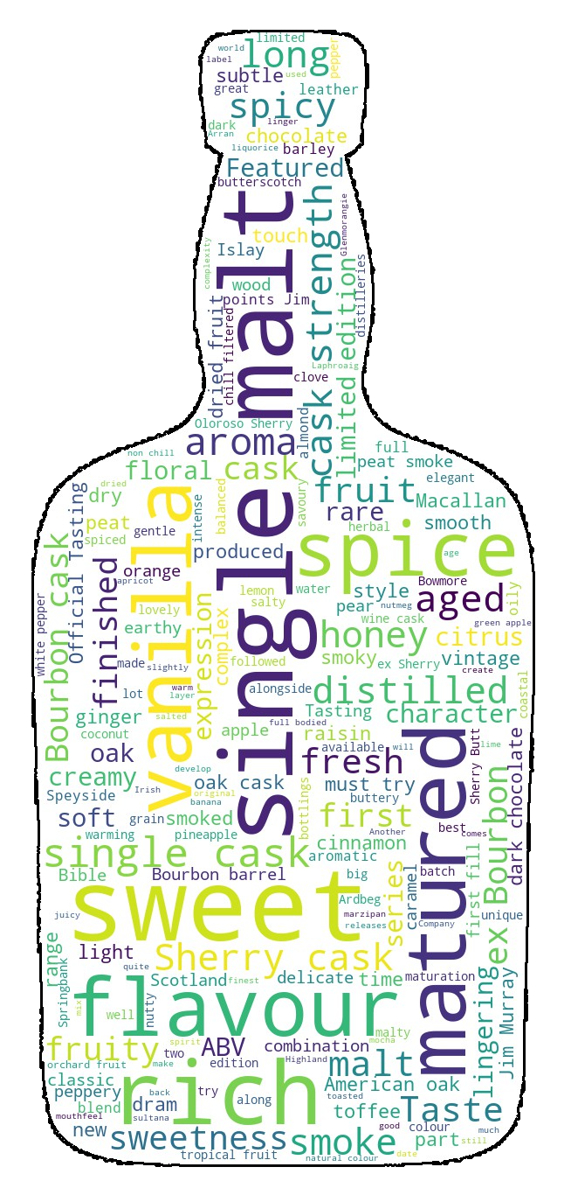
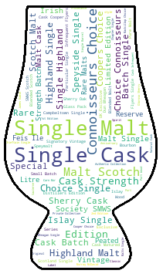
EDA:
Vanilla
Spice
Honey
Smoke
Citrus
Ginger
Toffee
Cinnamon
Chocolate
Dried Fruit
Description text
Series text

Slide 13
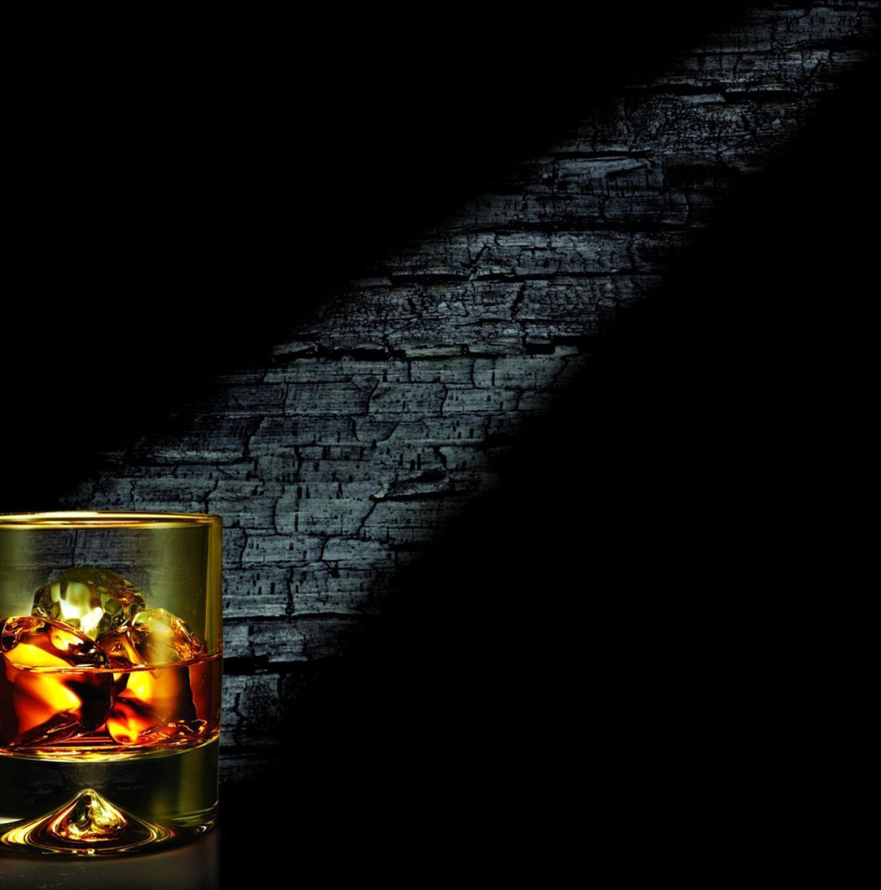
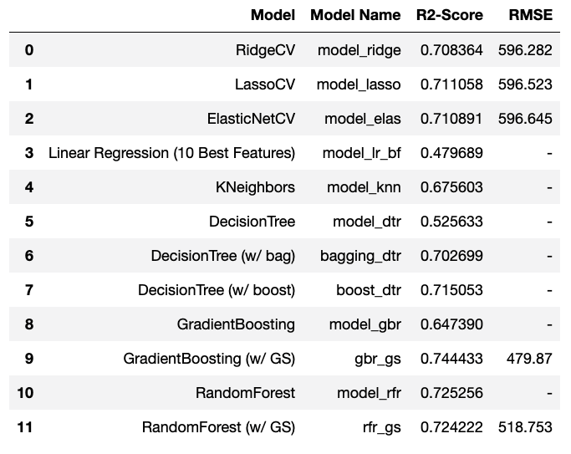
Models and Results:
Model Building:
Categorical features converted with get_dummies
Separated predictor and target variables
Split data into train and test subsets (test = 30%)
Rescaled variables using StandardScaler
Models fall broadly into 3 categories

Slide 14
Results continued:
Let’s take a look at the first 20 predictions…
Baseline ~ £460

Slide 15
Results continued:
Top 20 most important features…
Best features to predict whisky price:
Age
Vintage
Certain distilleries
Alcohol content
Sherry cask type
Cask strength

Slide 16
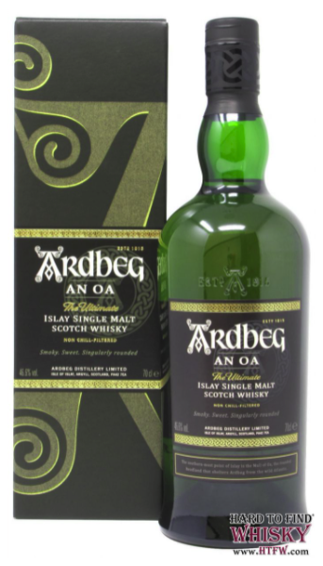
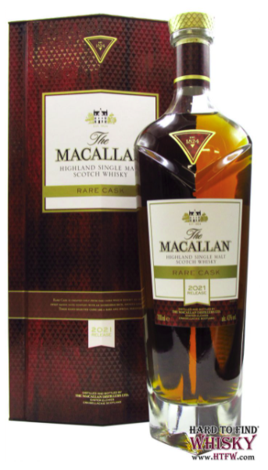
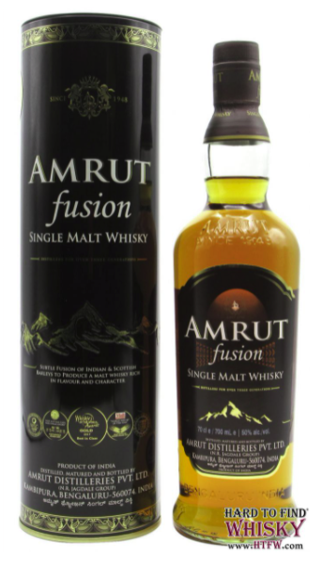

Use Case:
Identifying “Best Value” Whiskies
Here are some of the winners:
Ardbeg - AN OA Islay Single Malt Whisky
Macallan - Rare Cask 2021 Release Whisky
Remember the formula:
Value = $\frac{Predicted Price}{Actual Price}$
Amrut - Fusion Indian Single Malt Whisky
Predicted Price: £257.12
Actual Price: £48.80
Value: 5.3
Predicted Price: £ 1,520.73
Actual Price: £299.95
Value: 5.1
Predicted Price: £242.81
Actual Price: £44.75
Value: 5.4

Slide 17
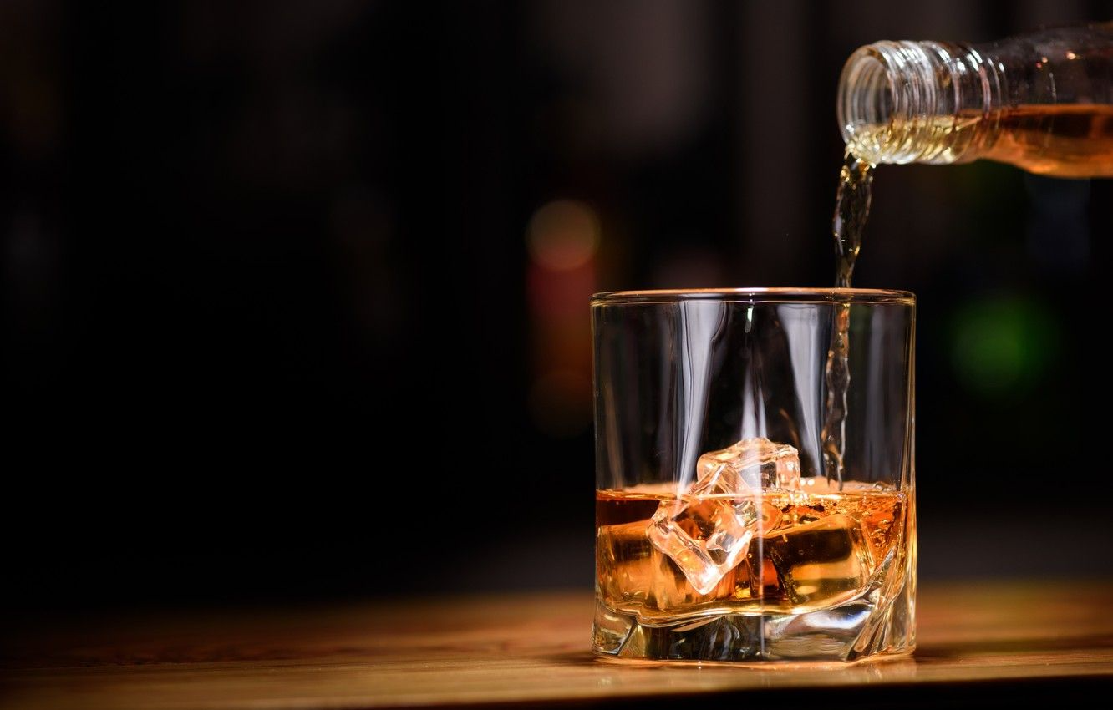
Next Steps:
Investigate converting categorical features with OneHotEncoder or others
Investigate other scalers (MinMax, Polynomial Features)
Investigate KNeighbors in more detail
Scrape data from websites in other countries notably Ireland, USA and Japan
Alternatively, focus on Scotland and investigate regions
Considering the relationship Year Bottled = Vintage + Age, how do my models perform using only 2 of these features

Slide 18
Questions?

